Slide 1
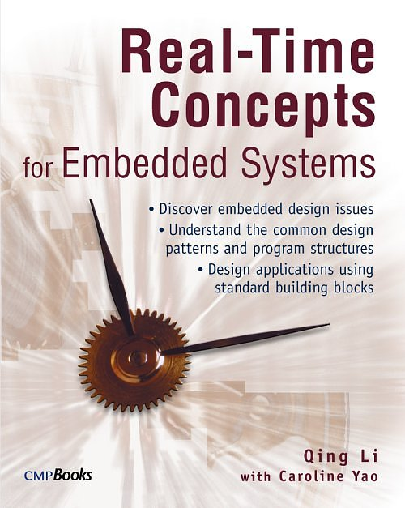
Real-Time Concepts for Embedded Systems
Author: Qing Li with Caroline Yao
ISBN: 1-57820-124-1
CMPBooks

Slide 2
Chapter 13
Memory Management

Slide 3
Outline
13.1 Introduction
13.2 Dynamic Memory Allocation in Embedded Systems
13.3 Fixed-size Memory Management in Embedded Systems
13.4 Blocking vs. Non-blocking Memory Functions
13.5 Hardware Memory Management Unit (MMU)

Slide 4
13.1 Introduction
Embedded systems developers commonly implement custom memory-management facilities on top of what the underlying RTOS provides
Understanding memory management is therefore an important aspect

Slide 5
Common Requirements
Regardless of the type of embedded system, the requirements placed on a memory management system
  Minimal fragmentation
  Minimal management overhead
  Deterministic allocation time

Slide 6
13.2 Dynamic Memory Allocation in Embedded Systems
The program code, program data, and system stack occupy the physical memory after program initialization completes
The kernel uses the remaining physical memory for dynamic memory allocation. – heap

Slide 7
Memory Control Block (Cont.)
Maintains internal information for a heap
  The starting address of the physical memory block used for dynamic memory allocation
  The size of this physical memory block
  Allocation table indicates which memory areas are in use, which memory areas are free
  The size of each free region

Slide 8
Memory Fragmentation and Compaction
The heap is broken into small, fixed-size blocks
  Each block has a unit size that is power of two
Internal fragmentation
  If a malloc has an input parameter that requests 100 bytes
  But the unit size is 32 bytes
  The malloc will allocate 4 units, i.e., 128 bytes
    28 bytes of memory is wasted

Slide 9
Memory Fragmentation and Compaction (Cont.)
The memory allocation table can be represented as a bitmap
Each bit represents a block unit

Slide 10
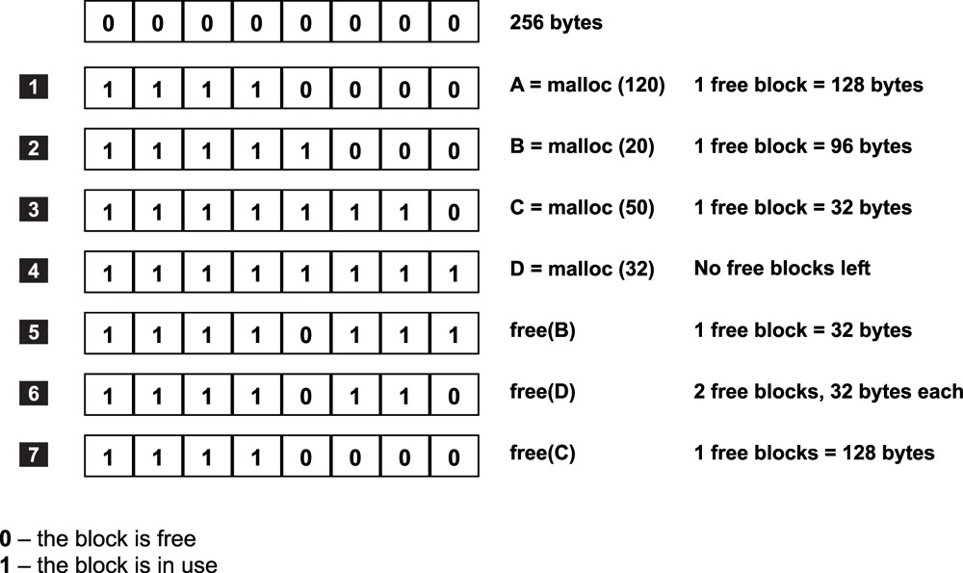
Example1: States of a Memory Allocation Map
Notes:
8x32=256

Slide 11
Memory Fragmentation and Compaction (Cont.)
Another memory fragmentation: external fragmentation
For example, 0x10080 and 0x101C0
  Cannot be used for any memory allocation requests larger than 32 bytes

Slide 12
Memory Fragmentation and Compaction (Cont.)
Solution: compact the area adjacent to these two blocks
  Move the memory content from 0x100A0 to 0x101BF to the new range 0x10080 to 0x1019F
    Effectively combines the two free blocks into one 64-byte block
  This process is continued until all of the free blocks are combined into a large chunk

Slide 13
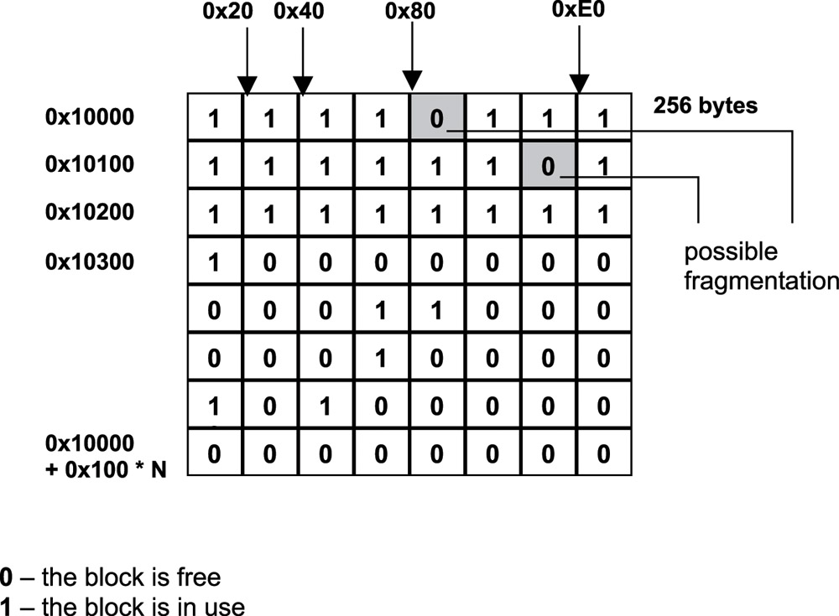
Example2: Memory Allocation Map with Possible Fragmentation

Slide 14
Problems with Memory Compaction
Time-consuming
Cost on copying data
The tasks that currently hold ownership of those memory blocks are prevented from accessing the contents of those memory locations during compaction
Almost never done in practice in embedded designs

Slide 15
Requirements for An Efficient
Memory Manager
An efficient memory manager needs to perform the following chores quickly:
  Determine if a free block that is large enough exists to satisfy the allocation request. (malloc)
  Update the internal management information (malloc and free).
  Determine if the just-freed block can be combined with its neighboring free blocks to form a larger piece. (free)
  The structure of the allocation table is the key to efficient memory management

Slide 16
An Example of malloc and free
Malloc’s allocation algorithm
We use a allocation array to implement the allocation map
Similar to the bitmap
  Each entry represents a corresponding fixed-size block of memory
However, allocation array uses a different encoding scheme
Notes:
How to implement allocation map. → using int array

Slide 17
An Example of malloc and free (Cont.)
Encoding scheme
  To indicate a range of contiguous free blocks
    A positive number is placed in the first and last entry representing the range
      The number is equal to the number of free blocks in the range
    For example: in the next slide, array[0] = array[11] = 12
  To indicate a range of allocated blocks
    Place a negative number in the first entry and a zero in the last entry
      The number is equal to -1 times the number of allocated blocks
    For example: in the next slide, array[9]=-3, array[11]=0

Slide 18
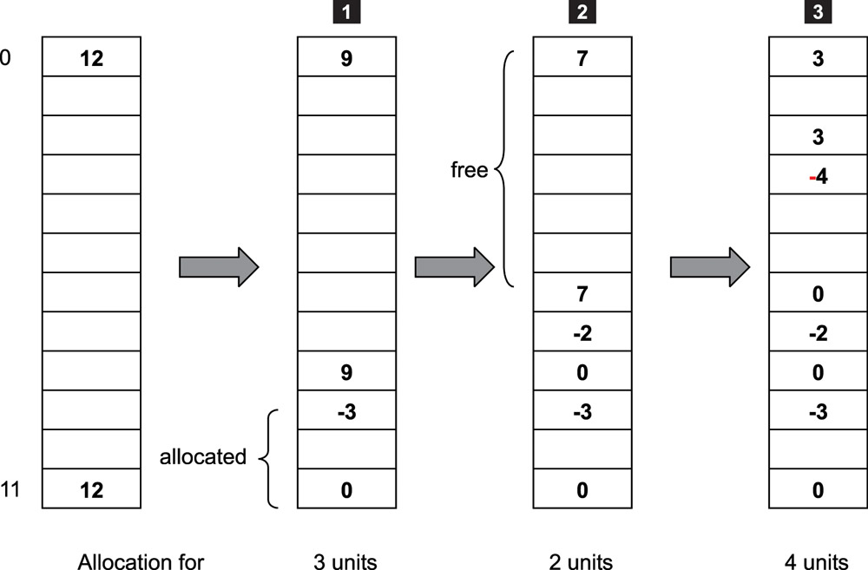
An Example of malloc and free
Static array implementation of the allocation map

Slide 19
Finding Free Blocks Quickly
malloc() always allocates from the largest available range of free blocks
  However, the entries in the allocation array are not sorted by size
  Find the largest range always entails an end-to-end search
Thus, a second data structure is used to speed up the search for the free block
  Heap data structure

Slide 20
Finding Free Blocks Quickly (Cont.)
Heap: a data structure that is a complete binary tree with one property
  The value contained at a node is no smaller than the value in any of its child nodes
The sizes of free blocks within the allocation array are maintained using the heap data structure
  The largest free block is always at the top of the heap

Slide 21
Finding Free Blocks Quickly (Cont.)
However, in actual implementation, each node in the heap contains at least two pieces of information
  The size of a free range
  Its starting index in the allocation array
Heap implementation
  Linked list
  Static array, called the heap array. See next slide

Slide 22
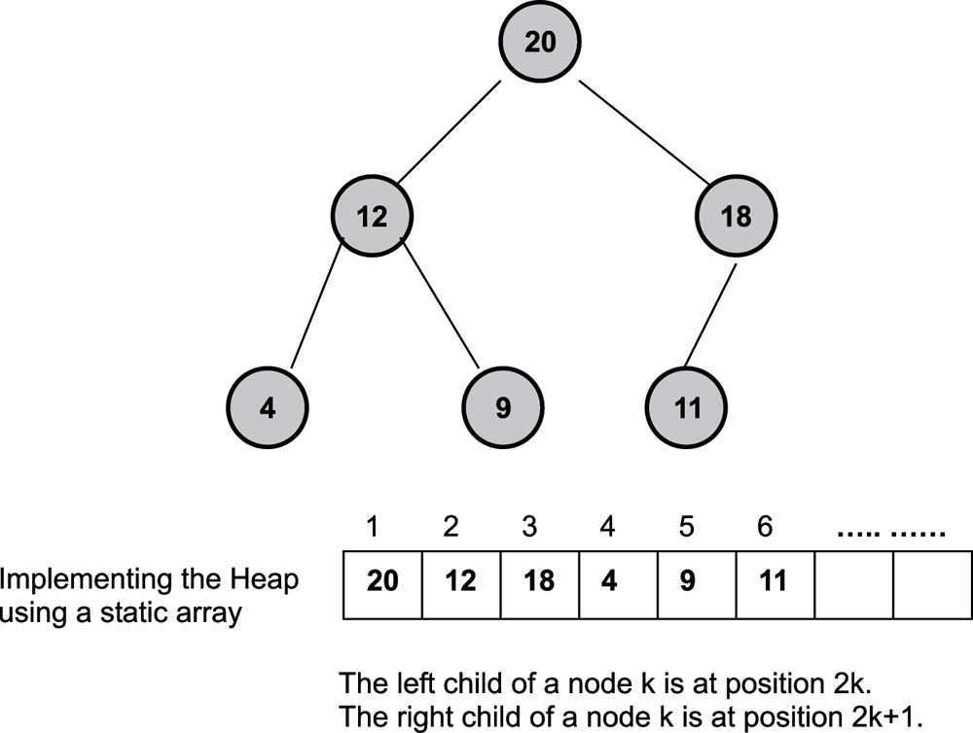
Free Blocks in a Heap Arrangement

Slide 23
The malloc() Operation
Examine the heap to determine if a free block that is large enough for the allocation request exists.
If no such block exists, return an error to the caller.
Retrieve the starting allocation-array index of the free range from the top of the heap.
Update the allocation array
If the entire block is used to satisfy the allocation, update the heap by deleting the largest node. Otherwise update the size.
Rearrange the heap array

Slide 24
The free Operation
free operation algorithm
The main operation of the free function
  To determine if the block being freed can be merged with its neighbors
Assume index points to the being freed block. The merging rules are
  Check for the value of the array[index-1]
    If the value is positive, this neighbor can be merged
  Check for the value of the array[index+number of blocks]
    If the value is positive, this neighbor can be merged

Slide 25
The free Operation
Example 1: the block starting at index 3 is being freed
  Following rule 1:
    Array[3-1]= array[2] = 3 > 0, thus merge
  Following rule 2
    Array[3+4] = array[7] = -3 < 0, no merge
Example 2:
  The block starting at index 7 is being freed
    Following rule 1and rule 2: no merge
  The block starting at index 3 is being freed
    Following rule 1 and rule 2: all both merges

Slide 26
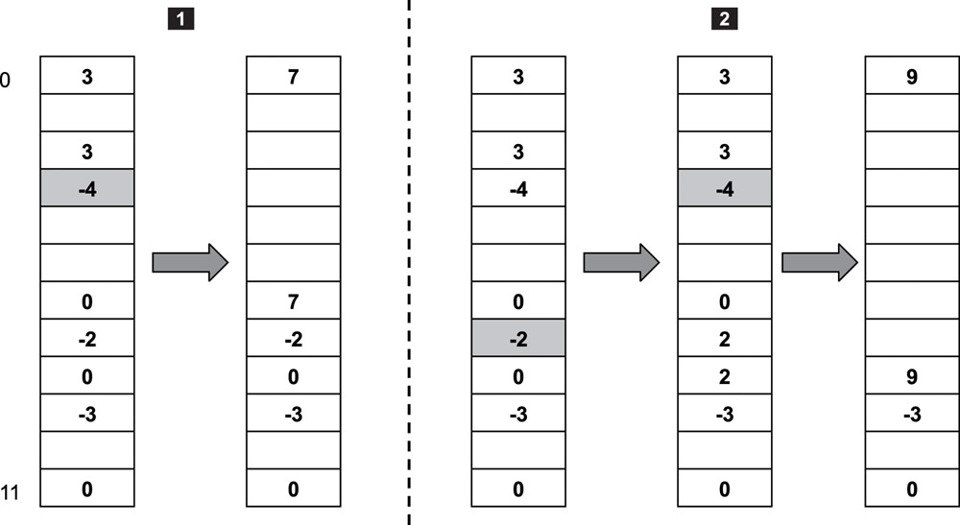
The free Operation

Slide 27
The free Operation
Update the allocation array and merge neighboring blocks if possible.
If the newly freed block cannot be merged with any of its neighbors.
  Insert a new entry into the heap array.
If the newly freed block can be merged with one of its neighbors
  The heap entry representing the neighboring block must be updated
  The updated entry rearranged according to its new size.
If the newly freed block can be merged with both of its neighbors
  The heap entry representing one of the neighboring blocks must be deleted from the heap
  The heap entry representing the other neighboring block must be updated and rearranged according to its new size.

Slide 28
13.3 Fixed-Size Memory Management in Embedded Systems
Another approach to memory management uses the method of fixed-size memory pools
The available memory space is divided into variously sized memory pools
  For example, 32, 50, and 128
Each memory-pool control structures maintains information such as
  The block size, total number of blocks, and number of free blocks

Slide 29
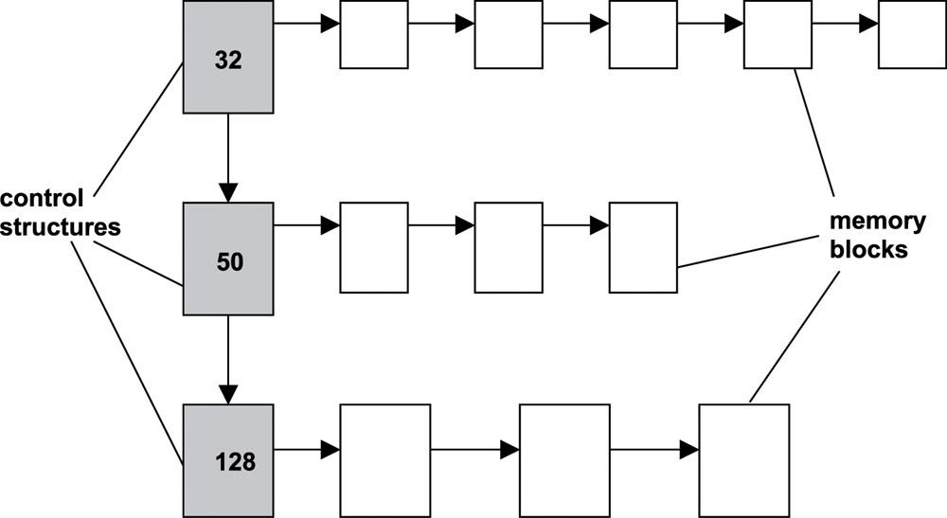
Fixed-Size Memory Management in Embedded Systems
Management based on memory pools

Slide 30
Fixed-Size Memory Management in Embedded Systems
Advantages
  More deterministic than the heap method algorithm (constant time)
  Reduce internal fragmentation and provide high utilization for static embedded applications
Disadvantages
  This issue results in increased internal memory fragmentation per allocation in dynamic environments
Notes:
Good for static but bad for dynamic.

Slide 31
13.4 Blocking vs. Non-Blocking
Memory Functions
The malloc and free functions discussed bofore do not allow the calling task to block and wait for memory to become available
However, in practice, a well-designed memory allocation function should allow for allocation that permits blocking forever, blocking for a timeout period, or no blocking at all

Slide 32
Blocking vs. Non-Blocking
Memory Functions (Cont.)
A blocking memory allocation can be implemented using both a counting semaphore and a mutex lock
  Created for each memory pool and kept in the control structure
  Counting semaphore is initialized with the total number of available memory blocks at the creation of the memory pool

Slide 33
Blocking vs. Non-Blocking
Memory Functions (Cont.)
The mutex lock is used to guarantee a task exclusive access to
  Both the free-blocks list and the control structure
Counting semaphore is used to acquire the memory block
  A successful acquisition of the counting semaphore reserves a piece of the available block from the pool

Slide 34
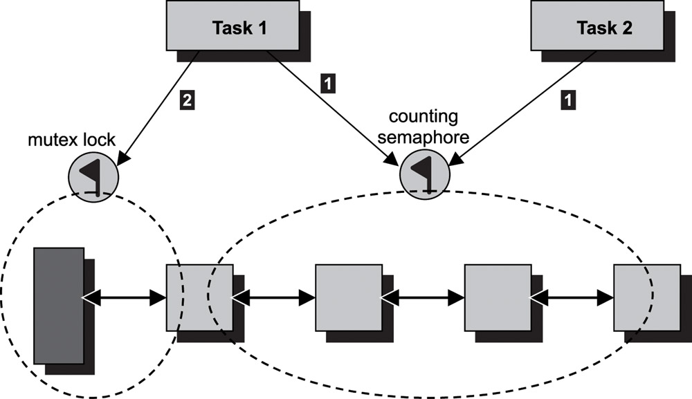
Implementing A Blocking Allocation Function: Using A Mutex and A Counting Semaphore

Slide 35
Blocking Allocation/Deallocation
Pseudo code for memory allocation
    Acquire(Counting_Semaphore)
    Lock(mutex)
    Retrieve the memory block from the pool
    Unlock(mutex)
Pseudo code for memory deallocation
    Lock(mutex)
    Release the memory block back to into the pool
    Unlock(mutex)
    Release(Counting_Semaphore)

Slide 36
Blocking vs. Non-Blocking
Memory Functions (Cont.)
A task first tries to acquire the counting semaphore
  If no blocks are available, blocks on the counting semaphore
Once a task acquire the counting semaphore
  The task then tries to lock the mutex to retrieves the resource from the list

Slide 37
13.5 Hardware Memory Management Units
The memory management unit (MMU) provides several functions
  Translates the virtual address to a physical address for each memory access (many commercial RTOSes do not support)
  Provides memory protection
If an MMU is enabled on an embedded system, the physical memory is typically divided into pages

Slide 38
Hardware Memory Management Units
Provides memory protection
  A set of attributes is associated with each memory page
    Whether the page contains code or data,
    Whether the page is readable, writable, executable, or a combination of these
    Whether the page can be accessed when the CPU is not in privileged execution mode, accessed only when the CPU is in privileged mode, or both
  All memory access is done through MMU when it is enabled.
    Therefore, the hardware enforces memory access according to page attributes

